Slide 1
CONSTRUCTING A BETTER BRITAIN

Slide 2
PRIORITIES FOR INDUSTRY
CAREERS
TRAINING AND
DEVELOPMENT
STANDARDS AND QUALIFICATIONS

Slide 3
THE BIG SIX
MAKING
CONSTRUCTION A CAREER
DESTINATION
CREATING A SITE-READY WORKFORCE
GROWING
APPRENTICESHIPS
INCREASING THE NUMBERS OF LEARNERS INTO WORKERS
HELPING SMALLER FIRMS
INVESTING IN ASSESSORS
1
2
3
4
5
6

Slide 4
CITB reform
Career destination
Innovation and productivity
Training and development

Slide 5
CITB REFORM
FUNDAMENTAL REFORM OF THE CITB ORGANISATION: STRATEGIC DIRECTION AND GOVERNANCE
Our Vision 2020 corporate change programme is leading organisational reform in six key areas: making us responsive, innovative, influential, accountable, representative and relevant. Reforms delivered have included:
Divestment: progressing for NCC Midlands (completed), NCC South (end 2019), Health and Safety Training, NCC Inchinnan and Bircham Newton (due spring 2020). NSAC (National Specialist Accredited Centre)/A&V (Assessment & Verification) decision pending.
Transparency: simpler 360-degree reports produced quarterly for industry since November 2018, a simpler and more interactive KPI dashboard, and six-monthly employer engagement events held across the three nations to share CITB progress and forthcoming plans.

Slide 6
CITB REFORM
SUPPORTING THE WHOLE INDUSTRY THROUGH STRATEGIC INVESTMENT
Investment has been directed to establishing an evidence base to understand the strategic needs of industry, understanding areas of need and future skills requirements. The Training Model is facilitating the creation of higher quality standards across the industry, and automated claim payments for short-duration training is driving more funds to SMEs. Funding priorities include:
Innovation: Over £3m invested into ‘Experiential Learning’, over £9.5m committed into ‘Pathways into Construction’, £3.3m committed for ‘Immersive Learning’ and £1.2m into ‘Offsite Upskilling’ projects.
High-quality training: funding has included £1.5m into 14 Assessment Infrastructure projects, £1m into Digital Leadership projects, £22m into 26 Construction Skills Fund projects (funding from DFE) and £17.8m earmarked for Onsite Experience projects.

Slide 7
CAREER DESTINATION
MORE WORKERS THROUGH DIVERSE TALENT POOLS
We are funding collaborative schemes with employers such as Kier and Bam Nuttall and specialists that are opening up employment opportunities to workers with transferable skills. Schemes include:
Step in and step up, supported 29 career changers and unemployed people, with 7 obtaining permanent jobs
Ex-offenders programme in Wales, 11 pilots set up across each National Probation Services region in Wales, engaging 170 ex-offenders and progressing 22 into employment.

Slide 8
CAREER DESTINATION
ATTRACTED MORE YOUNG PEOPLE TO A CAREER IN CONSTRUCTION
Since 2017 CITB have supported over 20,000 apprentices each year
30% increase in apprenticeship grants
New £500 apprentice grants for SMEs
Future Made – £10m funding over three years for a national cross-industry campaign to tackle perception challenges
CONSTRUCTION AMBASSADORS INSPIRE A NEW GENERATION
CITB have supported 1067 construction ambassadors, resulting in 13,000 engagements with young people – the next generation of construction
CHANGING THE CULTURE OF THE SECTOR
£970,000 Fairness Inclusion and Respect (FIR) Initiative training 1388 people from 698 companies through 37 seminars/workshops with further outcomes expected

Slide 9
CAREER DESTINATION
MORE YOUNG PEOPLE INSPIRED BY CONSTRUCTION
Face-to-face engagement with young people such as Inspiring Construction, in which the Scottish Contractors Group ran 17 events involving over 1750 pupils.
CREATED NEW PATHWAYS INTO CONSTRUCTION
Funding recruiting 772 women, career changers, and service leavers into sustainable jobs and sustainable training
GOCONSTRUCT
The GoConstruct website brings construction careers alive through free interactive learning resources. These include:
Go Bridge Building Challenge, a simple bridge-building activity which focuses on the role of civil engineers.
Building Communities, a lesson plan exploring geographical and sociological impacts of housing development

Slide 10
CAREER DESTINATION
JOBCENTRE PLUS PILOT
A Special Upskilling Programme in Dry Lining to re-engage 30 unemployed people with previous construction experience in the North East of England.
FIT OUT FUTURES
31,000 unemployed and full–time learners will be registered for red Experienced Worker CSCS cards, 352 candidates will undertake 2 week work experience.

Slide 11
INNOVATION AND PRODUCTIVITY
IMPROVING PERFORMANCE THROUGH PROCUREMENT
£3m investment will road-test procurement models designed to improve productivity throughout the supply chain
DEVELOPING TOMORROW’S DIGITAL LEADERS
£1.1 million awarded to a range of projects to develop the capability of leaders and managers to make strategic decisions and implement new technology in their businesses
Digital Construction BIM: 300 individuals being trained in BIM

Slide 12
INNOVATION AND PRODUCTIVITY
CITB supports projects which pilot new approaches based on identified needs,
Getting Offsite Ready: Construction Scotland Innovation Centre project delivering an offsite competency framework; Upskilling 500 trainers across three nations.
Immersive Learning: delivering learning in a more impactful way than traditional methods leading to better performance on site.
Passivhaus and low energy buildings: 11 e-learning modules aiming to improve productivity around the performance gap.
Supporting behavioural change within the UK’s aviation infrastructure: 2,250 employees undertaking safety in the working environment training of the Manchester Airport Group Estate
Constructionarium, seeking to engage at least 20 Universities, FE Colleges, UTCs or Organisations engaged with the Constructionarium.

Slide 13
INNOVATION AND PRODUCTIVITY
DEMOLITION MANAGER REFRESHER COURSE
Developed and tested with over 100 card holders renewing their accreditation.
TIMBER FRAME FIRE SAFETY GUIDANCE VIDEO
In response to industry’s CDM responsibilities, used in workshops and receiving 2,200 views online.
RESEARCH INVESTMENT FUND
Developing understanding of plant operator numbers, facilitating better planning for recruitment and upskilling nationally.
WOODWORKING CENTRES OF EXCELLENCE
Establishing a network of Centres of Excellence across the UK in response to industry skills gaps in joinery, shopfitting and interior contracting.
TIMBER FRAME COMPETENCY AWARD SCHEME
Set of new competency-based workbooks being created to support Scottish Modern Apprenticeship programmes in Timber Frame Manufacture and Design.

Slide 14
TRAINING AND DEVELOPMENT
TRAINING SUPPORT FOR THE SUPPLY CHAIN
£5m to Training Groups supporting over 1400 employers
£6m to SMEs via the Skills and Training Fund to more than 1,300 businesses in 2018/19 to strengthen industry
Over £1m investment in programmes to support Mental Health, aiming to train 288 practitioners, 3000 on-site mental health first aiders
Wilmott Dixon’s My home project, assessed and trained 953 employees, plus school children and community members in property maintenance.
CONTINUING TO SUPPLY SITE-READY BUILDERS THROUGH CONSTRUCTION SKILLS FUND
Construction Skills Fund supports 26 construction onsite training hubs
– £22m into construction skills
– Aiming to train 13,000 site-ready workers

Slide 15
TRAINING AND DEVELOPMENT
Supply chain school , £2.5m investment - the school supported 5,723 individual learners from 3,036 companies
Infrastructure 21, Cross-industry collaboration competence across UK’s infrastructure supply chain to deliver 50% increase in output in the next five years through engaging and upskilling priority areas.
National skills academy for construction, Since 2017, over 1,200 jobs have been created and over 6,700 qualifications & courses have been completed
OSAT, 136 finishes and interiors SME employees upskilled with L2 qualifications.
Reinforced concrete frame upskilling, worked with SMEs to upskill 99 employees from six companies to L2 qualification and take on 41 new apprenticeships.
Roofing Skills Partnership: £2.8m investment in an Accredited Roofer programme that is professionalising the industry with the aim of approving 5,000 roofers nationwide.

Slide 16
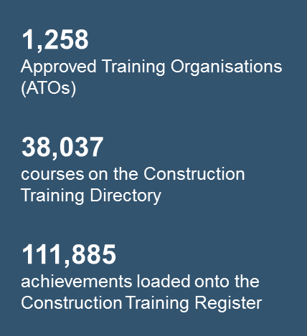
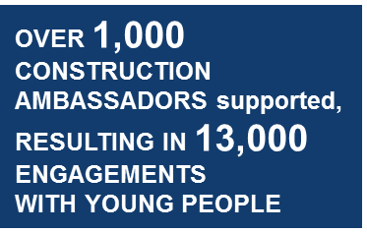
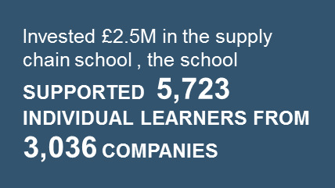
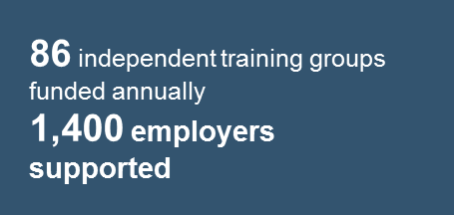
INSPIRING STUDENTS: After-school clubs offering construction experiences for students in 28 schools across Wales,
My home project, assessed and trained 953 employees
300 individuals being trained in BIM
Over £1M investment in programmes to support Mental health in the sector, aiming to train 288 PRACTITIONERS , 3000 ON- SITE MENTAL HEALTH FIRST AIDERS
11 NEW Passivhaus and low-energy buildings
E-LEARNING MODULES being developed
2,250 employees undertaking safety in the working environment training of the Manchester Airport Group Estate
CONSTRUCTION EMPLOYER FRAMEWORKS FOR EX-OFFENDERS IN WALES:
Set up 11 pilots across each national probation services region in wales, engaging 170 ex-offenders and progressing 22 into employment.
CHANGING THE CULTURE OF THE SECTOR through the £970,000 Fairness Inclusion and Respect (FIR) Initiative
Getting Offsite Ready: Upskilling 500 trainers across three nations.
£1.1M AWARDED TO PROJECTS THAT WILL DEVELOP DIGITAL LEADERS FOR THE CONSTRUCTION INDUSTRY
The Construction Skills Fund, DFE funded administered by CITB , has invested £22M.
Aiming to deliver 13,000 SITE-READY WORKERS

Slide 17
YOUR VIEW
HOW DO YOU SEE:
The role of CITB?
Your role?
The role of Build UK?

Slide 18
THANK YOU
If you have any further queries, please contact Andy Barron
andy.barron@citb.co.uk

